Slide 1

CS61B
Lecture 39: Compression, Complexity, and P = NP
Models of Compression
Kolmogorov Complexity (extra)
Space / Time Compression (extra)
P=NP? (Extra)
Is Short = Comprehensible? (Extra)

Slide 2
Another Look at Model 1 vs. Model 2 for Compression

Slide 3
Last Time: Compression
Bitstream B
Compressed bits C(B)
Compression
Algorithm C
01010101000001010101110...
1001010101...
C(B)
B
Decompression
Algorithm C⁻¹
1001010101...
01010101000001010101110...
We saw one technique for compression called Huffman Coding.
There are many other approaches to compression.
Interesting question: What is the best way to compress a given bitstream?

Slide 4
Comparing Compression Algorithms
Example: What is the best way to compress mobydick.txt?
One way to approach this problem: Try a bunch of different standard tools and see which yields the smallest size.
Algorithm | Uncompressed size (bits) | Compressed size (bits)
zip | 5145656 | 2091000
huffman | 5145656 | 3412896
bzip2 | 5145656 | 1805288

Slide 5
Comparing Compression Algorithms
Example: What is the best way to compress mobydick.txt?
One way to approach this problem: Try a bunch of different standard tools and see which yields the smallest size.
Algorithm | Uncompressed size (bits) | Compressed size (bits)
zip | 5145656 | 2091000
huffman | 5145656 | 3412896
bzip2 | 5145656 | 1805288
One problem: What if someone writes a custom compression algorithm?
If input is 0, return the entire text of Moby Dick.
If input is 1, return the entire text of Great Expectations.
For all other inputs, it just ignores the top bit and returns the rest.

Slide 6
Ultra Compression
public static String greatmobydecompress(Bitstream bs) {
if (bs.toInt() == 0) {
return "CALL me Ishmael. Some years ago never mind how...";
}
if (bs.toInt() == 1) {
return "It was the best of times, it was the worst of times...";
}
return bs.dropFirstBit().toString();
}
Algorithm | Uncompressed size (bits) | Compressed size (bits)
zip | 5145656 | 2091000
huffman | 5145656 | 3412896
bzip2 | 5145656 | 1805288
greatmobydecompress | 5145656 | 1

Slide 7
A Flaw in Compression Model #1
Source code for decompression algorithm itself might be highly complex.
To avoid this issue, we can include the number of bits for the source code of the algorithm itself.
Compressed Bits
5145656 bits
Decompression
Algorithm C⁻¹
1
0100001101000001...
1 bit
mobydick.txt
10561262 bits

Slide 8
Compression Models #1 and #2
Compression
Bitstream B
Compressed bits C(B)
Compression
Algorithm C
0100001101000001...
1
Decompression Model #1
C(B)
B
Decompression
Algorithm C⁻¹
1
0100001101000001...
Decompression Model #2: Include the code for the decompression algorithm as part of the compressed output.
mobydick.txt
01110000...1
Interpreter
GreatMobyDecompressWithHardCodedOneBit.java
0100001101000001...
5,145,656 bits
Decompression Algorithm and C(B)

Slide 9
Compression Model 2
The goal of a compression algorithm is to find short sequences of bits that generate desired longer sequences of bits.
Given a sequence of bits B, find a shorter sequence DA+C(B) that produces B when fed into an interpreter.
Great Moby Compression Algorithm
10,561,262
+ 1 =
10,561,263 bits
mobydick.txt
01110000...1
Interpreter
GreatMobyDecompressWithHardCodedOneBit.java
0100001101000001...
5,145,656 bits
Decompression Algorithm and C(B)

Slide 10
Compression Model 2
The goal of a compression algorithm is to find short sequences of bits that generate desired longer sequences of bits.
Given a sequence of bits B, find a shorter sequence DA+C(B) that produces B when fed into an interpreter.
Huffman Compression Algorithm
45,960 + 2,091,000 =
2,136,960 bits
mobydick.txt
01110000...1
Interpreter
HuffmanWithHardCoded CompressedMobyDick.java
0100001101000001...
5,145,656 bits
Decompression Algorithm and C(B)

Slide 11
Model 1 vs. Model 2 Compression
Algorithm | Uncompressed size (bits) | Compressed size (bits) | Compressed size using model 2 (bits)
zip | 5145656 | 2,091,000 | 2,091,000 + 67,160
huffman | 5145656 | 3,412,896 | 2,091,000 + 45,960
bzip2 | 5145656 | 1,805,288 | 2,091,000 + 74,984
greatmobydecompress | 5145656 | 1 | 1 + 10,561,262

Slide 12

Compression Model 2
The goal of a compression algorithm is to find short sequences of bits that generate desired longer sequences of bits.
Given a sequence of bits B, find a shorter sequence DA+C(B) that produces B when fed into an interpreter.
B
Huffman Compression Algorithm
45,960 + 1,994,024 =
2,039,984 bits
HugPlant.bmp
01110000...01110100...
Interpreter
HuffmanWithHardCoded CompressedHugPlant.java
0100001001001101...
8,389,584 bits
Decompression Algorithm and C(B)

Slide 13
Even Better Compression
Compression ratio of 25% is certainly very impressive, but we can do much better. MysteryX achieves a 0.35% compression ratio!
Of the 2⁸³⁸⁹⁵⁸⁴ possible bit streams of length 8389584, only one in 2⁸³⁶⁰¹⁵¹ can be generated by our interpreter using an input of length 29,432 bits.
HugPlant.bmp
01110000...01110100...
Interpreter
0100001001001101...
HuffmanWithHardCoded CompressedHugPlant.java
8,389,584 bits
2,037,424 bits
HugPlant.bmp
Interpreter
0110100101101101...
0100001001001101...
MysteryX
8,389,584 bits
29,432 bits

Slide 14
Even Better Compression
Compression ratio of 25% is certainly very impressive, but we can do much better. MysteryX achieves a 0.35% compression ratio!
Of the 2⁸³⁸⁹⁵⁸⁴ possible bit streams of length 8389584, only one in 2⁸³⁶⁰¹⁵¹ can be generated by our interpreter using an input of length 29,432 bits.
HugPlant.bmp
01110000...01110100...
Interpreter
0100001001001101...
HuffmanWithHardCoded CompressedHugPlant.java
8,389,584 bits
2,037,424 bits
HugPlant.bmp
Interpreter
0110100101101101...
0100001001001101...
MysteryX
8,389,584 bits
29,432 bits
Question: What is mystery X?

Slide 15
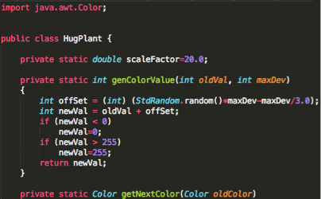
MysteryX: HugPlant.java
MysteryX is just HugPlant.java, the piece of code that I used to generate the .bmp file originally.
69 6d 70 6f 72 74 20 6a 61 76 61 2e 61 77 74 2e
43 6f 6c 6f 72 3b 0a 0a 0a 70 75 62 6c 69 63 20
63 6c 61 73 73 20 48 75 67 50 6c 61 6e 74 20 7b
0a 09 2f 2f 73 65 6e 64 20 65 6d 61 69 6c 20 74
6f 20 70 72 69 7a 65 40 6a 6f 73 68 68 2e 75 67
20 74 6f 20 72 65 63 65 69 76 65 20 79 6f 75 72
20 70 72 69 7a 65 0a 0a 09 70 72 69 76 61 74 65
20 73 74 61 74 69 63 20 64 6f 75 62 6c 65 20 73
63 61 6c 65 46 61 63 74 6f 72 3d 32 30 2e 30 3b
0a 0a 09 70 72 69 76 61 74 65 20 73 74 61 74 69
63 20 69 6e 74 20 67 65 6e 43 6f 6c 6f 72 56 61
6c 75 65 28 69 6e 74 20 6f 6c 64 56 61 6c 2c
B: HugPlant.bmp
Interpreter
0110100101101101...
0100001001001101...
C_{B}: HugPlant.java
8,389,584 bits
29,432 bits

Slide 16
Question #1: Comprehensible Compression
Interesting question #1:
Can we create a “comprehensible(可理解的)” compression(压缩) algorithm that takes as input a target bitstream B, and outputs useful, readable Java code?
“Comprehensible” Compression
B: HugPlant.bmp
Interpreter
0110100101101101...
0100001001001101...
C_{B}: HugPlant.java
8,389,584 bits
29,432 bits

Slide 17
Question #2: Optimal Compression
Interesting question #2:
Can we create an optimal compression takes as input a target bitstream B, and outputs the shortest possible Java program that outputs this bitstream?
Seems plausible that this optimal program would also have structure.
The answer turns out to be deep!
Optimal Compression
B: HugPlant.bmp
Interpreter
0110100101101101...
0100001001001101...
C_{B}: OptimalHP.java
8,389,584 bits
??? bits

Slide 18
Optimal Compression and Kolmogorov Complexity (Extra - CS172 Preview)

Slide 19
Kolmogorov Complexity
Given a target bitstream B, what is the shortest bitstream C_{B} that outputs B.
Definition: The Java-Kolmogorov complexity K_{J}(B) is the length of the shortest Java program (in bytes) that generates B.
Example: K_{J}(HugPlant.bmp) would be the length of OptimalHP.java.
There IS an answer. It just might be very hard to find.
Optimal Compression
B: HugPlant.bmp
Interpreter
0110100101101101...
0100001001001101...
C_{B}: OptimalHP.java
8,389,584 bits
??? bits

Slide 20
Kolmogorov Complexity
Given a target bitstream B, what is the shortest bitstream C_{B} that outputs B.
Definition: The Java-Kolmogorov complexity K_{J}(B) is the length of the shortest Java program (in bytes) that generates B.
There IS an answer. It just might be very hard to find.
Fact #1: Kolmogorov Complexity is effectively independent of language.
For any bit stream, the Java-Kolmogorov Complexity is no more than a constant factor larger than the Python-Kolmogorov Complexity.
Why?
B: HugPlant.bmp
Java Interpreter
0010000001110000...
0100001001001101...
C_{B}: OptimalHP.java
8,389,584 bits
??? bits

Slide 21
Kolmogorov Complexity (Language Independence)
Fact #1: Kolmogorov Complexity is effectively independent of language.
For any bit stream, the Java-Kolmogorov Complexity is no more than a constant factor larger than the Python-Kolmogorov Complexity.
Why?
Paul Hilfinger writes a Python program that is very short and uses weird Python features and I am stumped and cannot think of a similar thing in Java.
I could just write a Python interpreter in Java and then run Paul’s program.
K_{J}(B) ≤ K_{P}(B) + size(python interpreter)
B: HugPlant.bmp
Java Interpreter
0010000001110000...
0100001001001101...
C_{B}: OptimalPythonHPAnd
PythonInterpreter.java
8,389,584 bits

Slide 22
Kolmogorov Complexity (Language Independence)
Fact #1: Kolmogorov Complexity is effectively independent of language.
This is a deep fact!
It means that most bitstreams are fundamentally incompressible no matter what programming language we use for our compression algorithm.
Example: For all possible compression algorithms in all possible programming languages, a completely random sequence of 1,000,000 bits has at best, a 1 in 2⁴⁹⁹⁹⁹⁹ chance of being compressed by 50%.
B: HugPlant.bmp
Java Interpreter
0010000001110000...
0100001001001101...
C_{B}: OptimalPythonHPAnd
PythonInterpreter.java
8,389,584 bits

Slide 23
Kolmogorov Complexity (Uncomputability)
Fact #2: It is impossible to write a program that even calculates the Kolmogorov Complexity of any bitstream. Proof available here.
Corollary: If we can’t even compute the length of the shortest program, it is also impossible to write the “perfect” compression algorithm.
Optimal compression algorithm that works for all inputs does not exist! Leads to a logical fallacy.
Optimal Compression
B: HugPlant.bmp
Interpreter
0110100101101101...
0100001001001101...
C_{B}: OptimalHP.java
8,389,584 bits
??? bits

Slide 24
Space/Time Bounded Compression (Extra)

Slide 25
Question #2: Optimal Compression
Interesting question #2:
Can we create an optimal compression algorithm takes as input a target bitstream B, and outputs the shortest possible Java program that outputs this bitstream?
Unfortunately the answer is no. This is not possible, even theoretically.
No “optimal compression” algorithm exists.
Optimal Compression
B: HugPlant.bmp
Interpreter
0110100101101101...
0100001001001101...
C_{B}: OptimalHP.java
8,389,584 bits
??? bits

Slide 26
Question #2S: Space Bounded Compression
Interesting question #2S: Can we create a compression algorithm that:
Takes two inputs:
A target bitstream B.
A size S.
and outputs a Java program of length ≤ S that outputs B?
Let’s call this “space bounded compression”.
S
Space Bounded
Compression
B: HugPlant.bmp
Interpreter
0110100101101101...
0100001001001101...
C_{B}: SpaceBoundedHP.java
8,389,584 bits
≤ S bits

Slide 27
Question #2S: Space Bounded Compression
Interesting question #2S: Can we create a compression algorithm that:
Takes two inputs:
A target bitstream B.
A size S.
and outputs a Java program of length ≤ S that outputs B?
No! Could be used to find K_{J}(B).
How? Binary search on S.
S
Space Bounded
Compression
B: HugPlant.bmp
Interpreter
0110100101101101...
0100001001001101...
C_{B}: SpaceBoundedHP.java
8,389,584 bits
≤ S bits

Slide 28
Question #2ST: Space/Time Bounded Compression
Interesting question #2ST: Can we create a compression algorithm that:
Takes three inputs:
A target bitstream B.
A size S.
A maximum number of lines of bytecode executed T.
and outputs a Java program of length ≤ S that outputs B in fewer than T executed lines of bytecode?
S
T
Space/Time Bounded
Compression
B: HugPlant.bmp
Interpreter
0110100101101101...
0100001001001101...
C_{B}: SpaceBoundedHP.java
8,389,584 bits
executes ≤ T lines of bytecode
≤ S bits

Slide 29
Question #2ST: Space/Time Bounded Compression
Interesting question #2ST: Can we create a space/time bounded compression algorithm? Yes! And here’s an algorithm:
For each possible program p of length S or less:
If p compiles, run program p until either:
p terminates.
We output B.
T lines of bytecode are executed.
Runtime: O(T x 2^{S})
S
T
Space/Time Bounded
Compression
Treating B as a constant.
B: HugPlant.bmp
Interpreter
0110100101101101...
0100001001001101...
C_{B}: SpaceBoundedHP.java
8,389,584 bits
executes ≤ T lines of bytecode
≤ S bits

Slide 30
Question #2ST-E: Space/Time Bounded Compression
Interesting question #2ST-E: Can we create an efficient space/time bounded compression algorithm?
Need to make a more precise definition of what we mean by “efficient”.
Turns out to be closely related to an important puzzle in computer science: Does P = NP?
Will study carefully in 170. But let’s take a quick look.
S
T
Efficient Space/Time Bounded
Compression
B: HugPlant.bmp
Interpreter
0110100101101101...
0100001001001101...
C_{B}: SpaceBoundedHP.java
8,389,584 bits
executes ≤ T lines of bytecode
≤ S bits

Slide 31
P = NP? (Extra)

Slide 32
Surprising Fact
An efficient solution to any of these three problems:
3SAT
Independent Set, a.k.a. INDSET
Longest Path, a.k.a. LONGEST_PATH
Would also give an efficient space/time bounded compression algorithm.
Why?
Space/time bounded compression reduces to 3SAT, INDSET, and LONGEST_PATH*.
*: And also tens of thousands of other related problems.

Slide 33
3SAT and Space/Time Bounded Compression
Example:
Let X = “Does there exist a Java program that outputs , and:
is of of length 20,000 or less.
produces this output in fewer than 1,000,000 executed lines of bytecode.”
X can be transformed into a longest paths problem (or a 3SAT problem or an independent set problem).

Slide 34
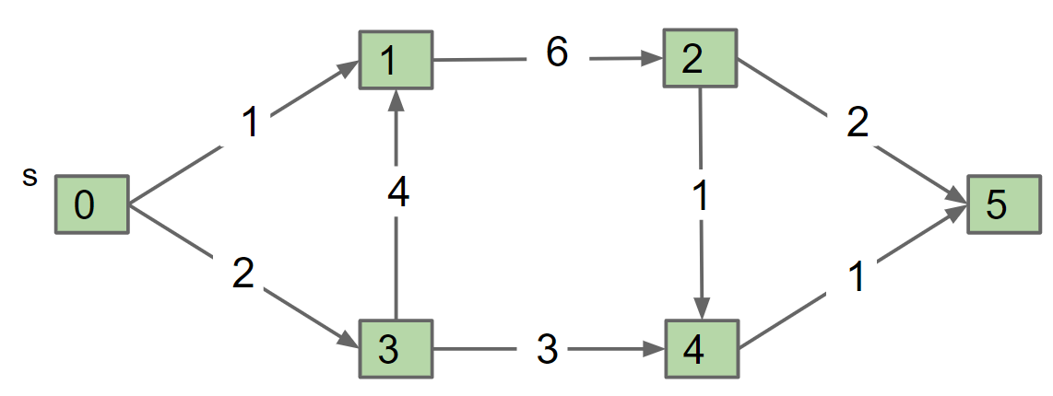
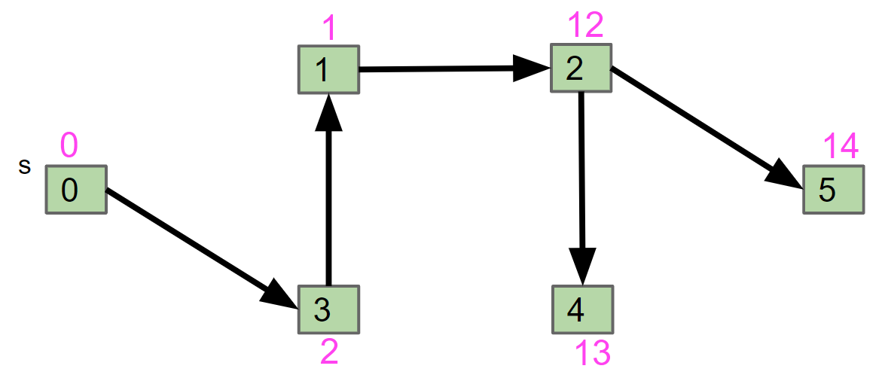
Visual Reduction
LONGEST_PATH can be used to solve Bounded Space/Time Compression.
The actual graphs to represent our problem will be phenomenally complex. See 170 if you’re curious how this reduction works.
Bounded Space/Time Compression
20,000
10,000,000
G
Preprocess
LONGEST_PATH
Java code of length < 20,000 bits that outputs HugPlant in 10,000,000 executed bytecode lines.
Postprocess
path of weight > W

Slide 35
3SAT and Space/Time Bounded Compression
Example:
Let X = “Does there exist a Java program that outputs , and:
is of of length 20,000 or less.
produces this output in fewer than 1,000,000 executed lines of bytecode.”
X can be transformed into a longest paths problem (or a 3SAT problem or an independent set problem).
How do we know X can be turned into a longest paths problem?
Short answer: “It’s a problem in the complexity class NP and therefore can be reduced to any NP complete problem, including longest paths”.
I haven’t introduced many of the terms in this statement. We will very briefly go over them, but too quickly to make complete sense.
Longer answer: See CS170.

Slide 36
P = NP?
Two important classes of yes/no problems:
P: Efficiently solvable problems.
NP: Problems with solutions that are efficiently verifiable.*
Examples of problems in P:
Is this array sorted?
Does this array have duplicates?
Examples of problems in NP:
Is there a solution to this 3SAT problem?
In graph G, does there exist a path from s to t of weight > k?
*: Technically it’s problems for a which a “yes” answer is efficiently verifiable.

Slide 37
P = NP?
Two important classes of yes/no problems:
P: Efficiently solvable problems.
NP: Problems with solutions that are efficiently verifiable.*
Examples of problems not in NP:
Is this the best chess move I can make next?
Hard to verify.
What is the longest path?
Not a yes/no question.
*: Technically it’s problems for a which a “yes” answer is efficiently verifiable.

Slide 38
Totally Shocking Fact
Every single NP problem reduces to 3SAT.
This includes Bounded Space/Time Compression.
In other words, any decision problem for which a yes answer can be efficiently verified can be transformed into a 3SAT problem.
This transformation is also “efficient” (polynomial time).
This result is by Cook (1971) and Levin (1973). See Cook-Levin Theorem for more.

Slide 39
Open Question in Computer Science
Question posed Stephen Cook in 1971: Are all NP problems also P problems?
In other words, are all problems with efficiently verifiable solutions also efficiently solvable?
Often stated as “Does P = NP?”
One reason to think yes:
Easy to check any given answer.
Maybe with the right pruning rules you can zero in on the answer?
See CS170 for a much more thorough and formal treatment of this problem.

Slide 40
Almost Like Gods (Extra)

Slide 41
P = NP?
Consensus Opinion (Bill Gasarch Poll, 2012 poll)
83%: P ≠ NP (126 respondents)
9%: P = NP (12 respondents)
9%: Other (13 respondents)
Why is opinion generally negative?
Someone would have proved it by now.
“The only supporting arguments I can offer are the failure of all efforts to place specific NP-complete problems in P by constructing polynomial-time algorithms.” - Dick Karp
Creation of solutions seems philosophically more difficult than verification.
What is that?

Slide 42
NP Complete Problems
It turns out that there are tons of NP problems that all reduce to each other.
Solving any of these problems means that you have solved all of them.
These problems are known as “NP Complete” problems.
There are tens of thousands of them, and none have been solved.
3-SAT
Hamiltonian Cycle
Independent Set
Decision version of TSP
Hamiltonian Path
Two-Prime Integer Factorization
Purple: NP-Complete
White: NP, not known to be NP complete.

Slide 43
Fun Fact: Mathematical Proofs Are in NP!
Example of NP problem: Is there a proof that the Riemann Hypothesis is true?
A yes answer can be easily verified (we just need to check the proof).
If P=NP, then mathematical proof can be automated!
P=NP means checking a proof is roughly as easy as creating the proof.
First observed informally by Kurt Gödel himself.
“[A linear or quadratic-time procedure for what we now call NP complete problems would have] consequences of the greatest magnitude. [For such a procedure] would clearly indicate that, despite the unsolvability of the Entscheidungsproblem, the mental effort of the mathematician in the case of yes-or-no questions could be completely replaced by machines.” - Kurt Gödel

Slide 44
One of These Things, Is Not Like The Others
In 2000, the Clay Mathematics Institute set up $1,000,000 prizes for the solution of each of seven problems.
Millenium Prize Problems.
Hodge conjecture
Poincare conjecture (solved!)
Riemann hypothesis
Yang-Mills existence and mass gap
Navier-Stokes existence and smoothness
Birch and Swinnerton-dyer conjecture
P=NP
If true, proof might allow you to trivially solve all of these problems.

Slide 45
Question #2ST-E: Space and Time Bounded Compression
Back to our earlier quest:
Since Space/Time Bounded Compression can be reduced to 3SAT (or LONGEST_PATH or INDSET or any other NP complete problem), an efficient solution to any NP complete problem would act as a compression algorithm.
S
T
Efficient Space/Time Bounded
Compression
B: HugPlant.bmp
Interpreter
0110100101101101...
0100001001001101...
C_{B}: SpaceBoundedHP.java
8,389,584 bits
executes ≤ T lines of bytecode
≤ S bits

Slide 46
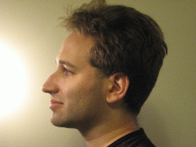
Even More Impressive Consequences
Even More Impressive Consequences
“I have heard it said, with a straight face, that a proof of P = NP would
be important because it would let airlines schedule their flights better, or
shipping companies pack more boxes in their trucks!
If [P = NP], then we could quickly find the smallest Boolean circuits that output (say) a table of historical stock market data, or the human genome.... It seems entirely conceivable that, by analyzing these circuits, we could make an easy fortune on Wall Street, or retrace evolution... For broadly speaking, that which we can compress we can understand, and that which we can understand we can predict.
So if we could solve the general case—if knowing something was tantamount to knowing the shortest efficient description of it—then we would be almost like gods. [Assuming P ≠ NP] is the belief that such power will be forever beyond our reach.”
- Scott Aaronson http://www.scottaaronson.com/papers/npcomplete.pdf

Slide 47
Does Short = Comprehensible? (Extra)

Slide 48
Back to Question #1: Comprehensible Compression
Earlier, we’d hoped for “comprehensible compression”.
Scott Aaronson earlier made an implicit conjecture that a short program will also be comprehensible.
This seems feasible (but not obvious) to me.
A short program will probably exhibit hierarchy and structure.
Example might even look like HugPlant.java.
“Comprehensible” Compression
B: HugPlant.bmp
Interpreter
0110100101101101...
0100001001001101...
C_{B}: ReadableHP.java
8,389,584 bits
29,432 bits

Slide 49
Comprehensible Compression of Other Data
Scott also conjectures that if we fed in useful data about the stock market, we’d effectively get back a useful economy simulator.
Could read the source code to understand how the world works.
Some sort of relatively short Java program that acts as a simulator for the world economy that we can read through and understand.
All business reports by every business ever along with stock market data.
“Comprehensible” Compression
B: marketData.csv
Interpreter
0110100101101101...
01001010010100...
C_{B}: EconomySimulator.java

Slide 50
Complexity from Simple Rules
However, there are also reasons to suspect that simplicity might not indicate comprehensibility.
Earlier, we said that compressibility was a rare thing.
And yet, short programs can produce surprisingly complex output.

Slide 51
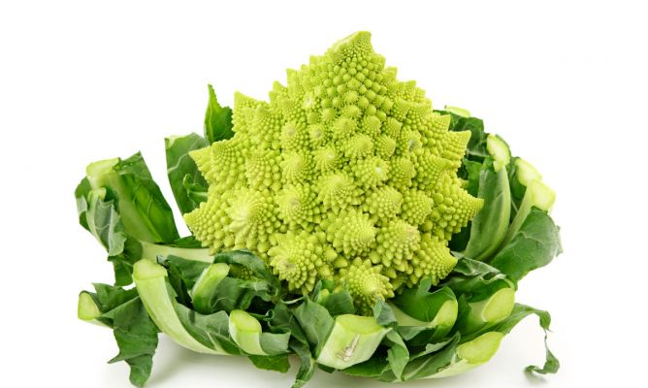
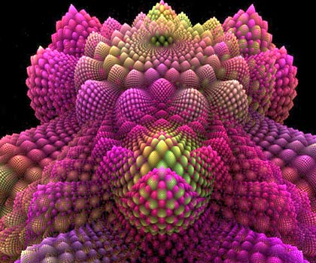
Fractals
In the 1970s, Mandelbrot built demonstrations that very short programs could generate highly complex visual patterns.
Biological processes exploit these same ideas. Short sequences of DNA give rise to interesting spatial (and other) patterns.

Slide 52

The Mandelbrot Set
S
T
Bounded Space/Time Compression
???

Slide 53
Short (But Simple)?
...
public class Mandelbrot extends JFrame {
...
for (int y = 0; y < getHeight(); y++) {
for (int x = 0; x < getWidth(); x++) {
zx = zy = 0;
cX = (x - 400) / ZOOM;
cY = (y - 300) / ZOOM;
int iter = MAX_ITER;
while (zx * zx + zy * zy < 4 && iter > 0) {
tmp = zx * zx - zy * zy + cX;
zy = 2.0 * zx * zy + cY;
zx = tmp;
iter--;
}
I.setRGB(x, y, iter | (iter << 8));
}
}
...
}
Hard to say what we learn by looking at this code.
Very basic rules yield such a highly complex object.
… but I’m not the complexity theorist!
S
T
Bounded Space/Time Compression

Slide 54
Music from Simple Rules
This notion of complexity from simple rules is arguably more interesting (and alarming) when applied towards sound generation.
Music from very short programs (3rd iteration): Youtube
See this link if you want to try writing your own fractal sound generator.
Or you can try playing around with this javascript version that I used in my freshman seminar on generative art.
Fun program: return 100 * (t & (t >> 3) & (t >> 8)) % 16384;
See these slides for examples of interesting inputs.

